Slide 1
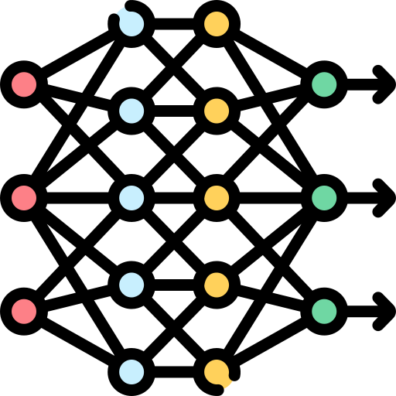
Deep Learning Foundations
Neural Networks • Representation Learning • Multimodal Embeddings
Dr. Khan Muhammad (칸무하마드)
Associate Professor
Department of Applied Artificial Intelligence
Sungkyunkwan University, Seoul.

Slide 2
Main contents
From Multimodal AI to Deep Learning
Deep Learning Foundations
  Neural Networks
  The Artificial Neurons
  Activation Functions
How Neural Networks Learn
  Forward Propagation
  Loss & Cost Functions
  Backpropagation
  Optimization Algorithms
  Training Process
Representation Learning
  Learned Features
  Embeddings
  Latent Space
  Embeddings & Latent Space (both)
2

Slide 3
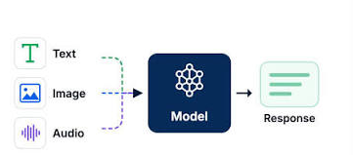
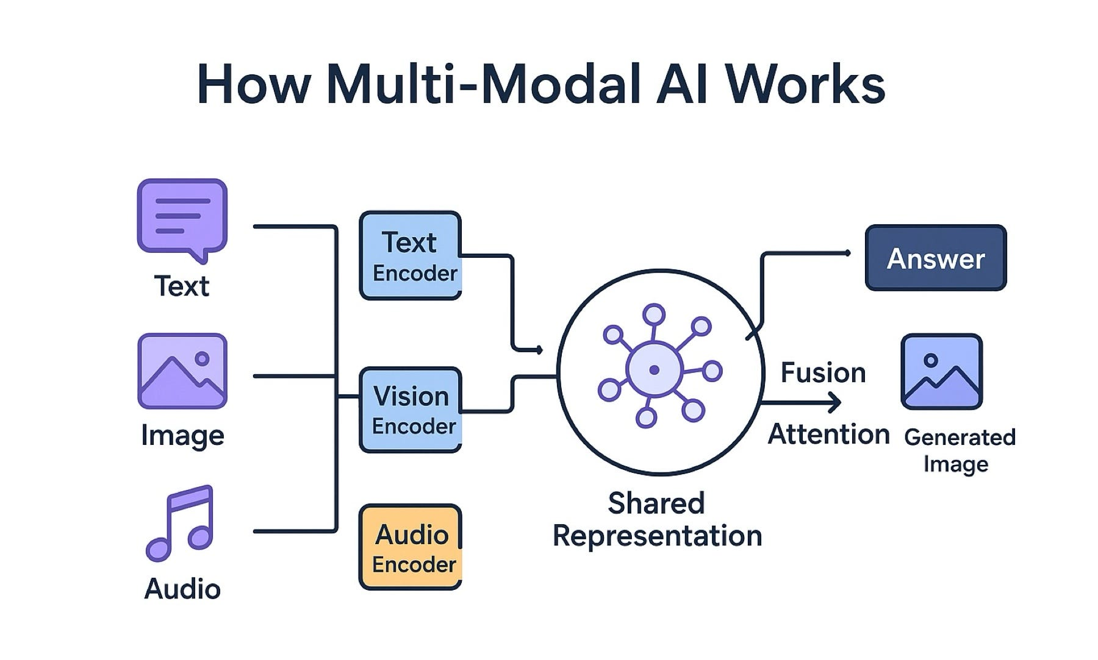
1. From Multimodal AI to Deep Learning
What Did We Learn in Previous lecture (s)?
Multimodal AI works with different types of information:
  Images
  Text
  Audio
  Video
It learns to understand, connect, and use information across modalities
What Do We Need Next?
How can machines learn useful information from data?
How can data become useful representations?
How can these representations be connected and compared?
Answer: Deep Learning
Deep learning learns useful representations from data.
3

Slide 4
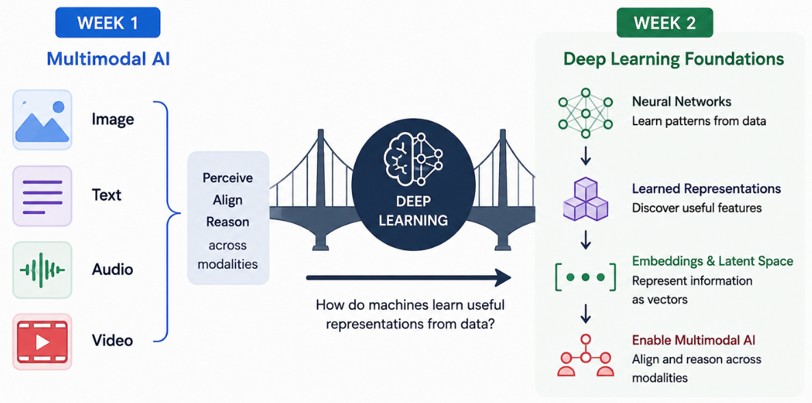
1. From Multimodal AI to Deep Learning (Con…)
Previously Covered
Today’s/Next Focus
Multimodal AI tells us WHAT information we want to combine; deep learning helps us learn HOW to represent that information.
4

Slide 5
2. Deep Learning Foundations
5

Slide 6
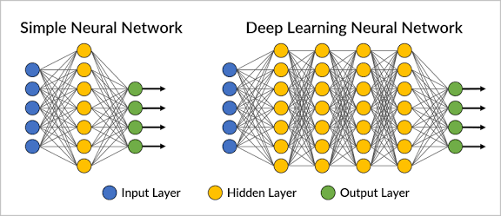
2. Deep Learning Foundations
Deep Learning is a way for computers to learn patterns from data using neural networks with multiple layers.
In simple words:
Data → Learn Patterns → Make Predictions
Three Basic Ideas
Learns from data instead of relying only on manually designed rules.
Learns useful representations from simple to complex patterns.
Uses multiple layers to gradually transform the input into a useful output.
Deep learning learns useful patterns and representations from data.
6
Notes:
RNN vs. CNN vs. NN
NN (basic neural network): Processes inputs independently; no explicit memory of previous inputs. Examples: Perceptron, Multilayer Perceptron.
CNN: Learns spatial patterns such as edges, shapes, and objects—commonly used for images. Examples: LeNet-5, RestNet etc.
RNN: Learns sequential/temporal patterns by remembering previous information; commonly used for text, speech, and time-series data. Examples: LSTM and Gated Recurrent Unit (GRU).
Simple analogy:
NN = learns relationships between input and output
CNN = looks at “where” things are
RNN = remembers “what came before”

Slide 7
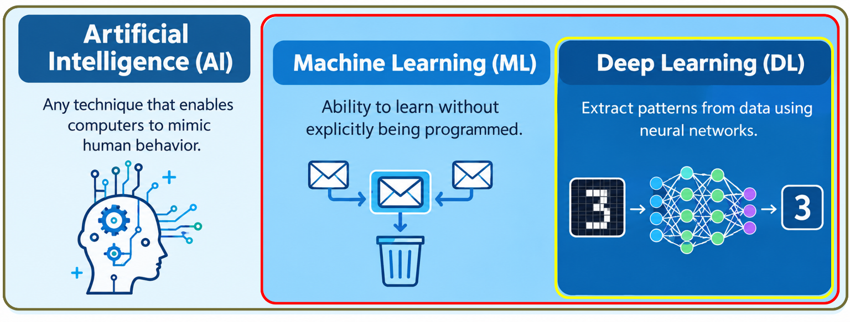
2. Deep Learning Foundations (Con…)
Teaching computers how to learn a task directly from raw data
AI is the big umbrella.
ML is the branch of AI
DL is the branch of ML
Artificial Intelligence (AI)
Making computers perform tasks that normally need human intelligence.
Examples:
Face recognition • Voice assistants • Chess-playing computers
Figure: Relationship between Artificial Intelligence, Machine Learning, and Deep Learning.
Deep Learning (DL)
A type of ML that uses neural networks to learn complex patterns automatically.
Examples:
Feed raw email text directly into a neural network → it automatically extracts complex word patterns and context to identify spam.
Recognizing faces, handwritten numbers, or objects in images
Machine Learning (ML)
Teaching computers to learn from examples and make decisions.
Example:
Give a computer pre-defined features (e.g., word count, keywords) from emails → it learns to identify new spam emails.
7

Slide 8
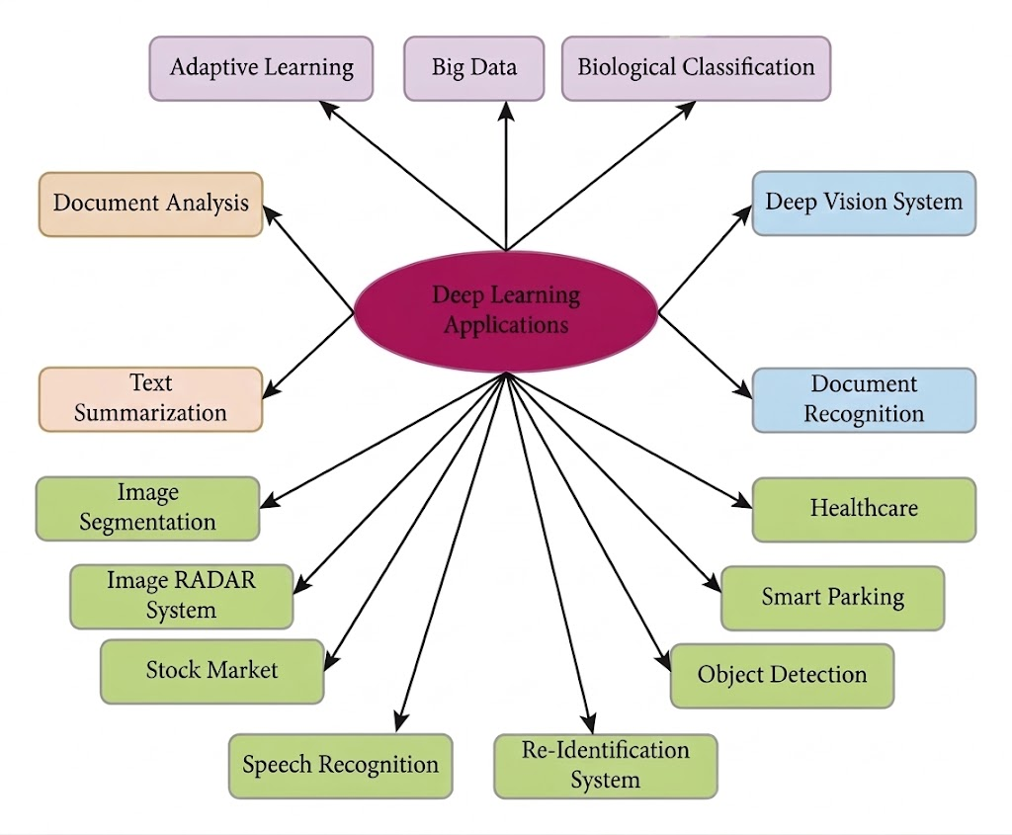
2. Deep Learning Foundations (Con…)
Deep Learning Applications
Figure: A clear mind map showing practical applications of deep learning across computer vision, text processing, healthcare, and financial analysis.
8

Slide 9
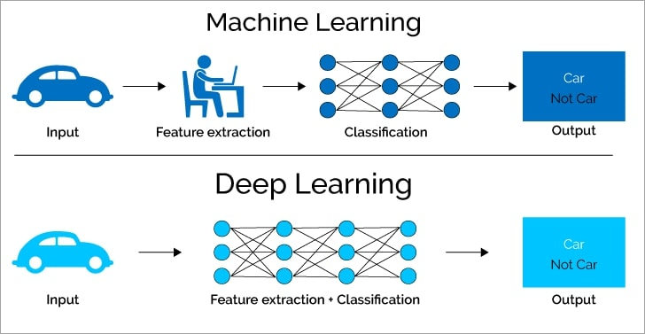
2. Deep Learning Foundations (Con…)
Why Do We Need Deep Learning?
Traditional Approach: Handcrafted Features
Humans manually choose useful features.
Features may work well for simple problems.
Complex data can contain patterns that are difficult to define manually.
Designing features becomes difficult as data becomes more complex.
Deep Learning
Learns useful features automatically from data.
Can learn simple → complex patterns through multiple layers.
Traditional ML (manual): Humans design the features.
Deep Learning (automatic): The model learns the features.
9

Slide 10
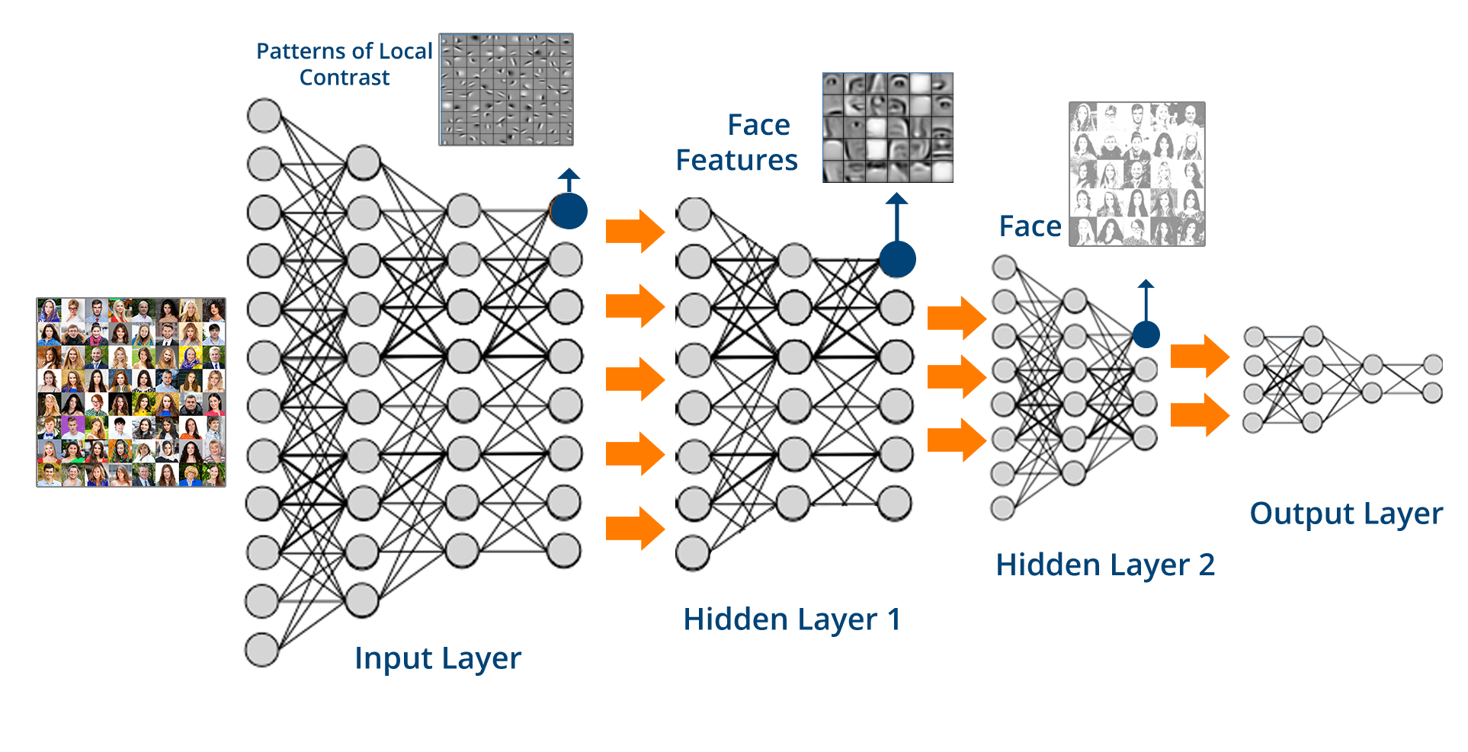
2. Deep Learning Foundations (Con…)
How does Deep Learning works?
Deep learning automatically learns features from raw data through multiple hidden layers, gradually transforming them into meaningful representations for prediction.
At the core of deep learning are neural networks, which learn these patterns through interconnected layers.
10

Slide 11
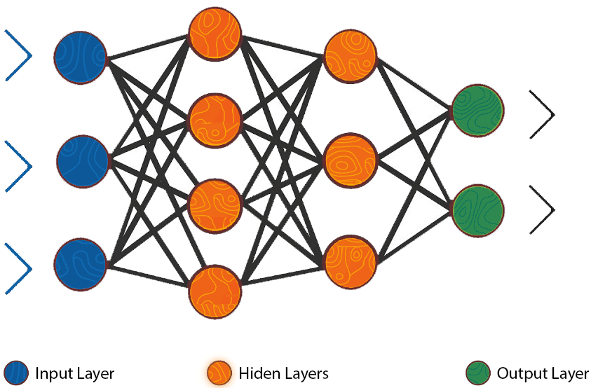
2 (i). Neural Network
A neural network is a model that learns patterns from data.
It is made of connected neurons arranged in layers.
Each layer processes information and passes it to the next layer.
During training, the network learns how strongly neurons should be connected.
Three Main Parts
Input Layer → receives the data
Hidden Layers → learn patterns
Output Layer → produces the result
A neural network learns to turn input data into useful predictions.
11
Notes:
Pinch a Person (Example)
Sensory Neurons (Skin): Pressure sensors in the skin detect the pinch and generate an electrical pulse.
Peripheral Nerves (Wire): Fast-acting nerve fibers shoot the signal up the arm toward the spine.
Spinal Cord (Highway): The spine receives the message and sends it straight up to the brain.
Brain (Processor):
Location: The somatosensory cortex figures out where and how hard you pinched.
Emotion: The limbic system triggers the annoyance or "ouch" response.
Bridge to Neural Networks
Biology Artificial Neural Network (ANNs)
Skin sensors Input Layer: Receives raw features (e.g., pressure intensity, pixels, text).
Nerve fibers / Spine Hidden Layers: Transmits and transforms signals across weighted connections.
Brain processing Output Layer: Makes the final decision (e.g., "Pinch detected" or "Classify as Spam").

Slide 12

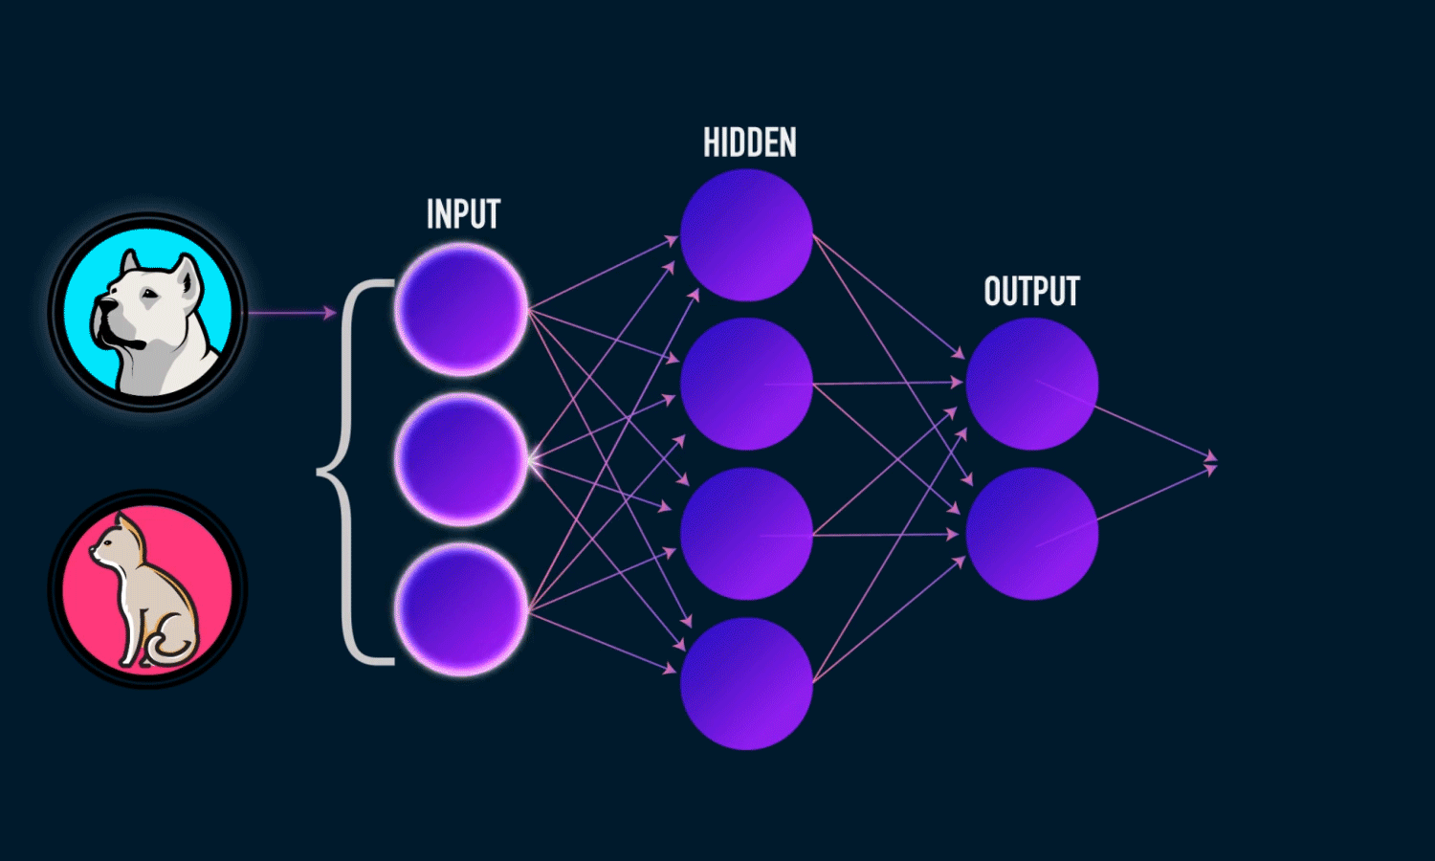

2 (ii). The Artificial Neuron
A neuron is the basic building block of a neural network.
It receives inputs, gives each input a weight, adds a bias, and produces an output.
Artificial Neuron is also called a Perceptron.
Main Components
Inputs (x) → information coming in
Weights (w) → importance given to each input
Bias (b) → helps adjust the result
Weighted Sum → combines the inputs
Output (z) → result passed to the next layer
Equation
A neuron combines information from its inputs to produce an output.
  Rosenblatt, F. (1958), The Perceptron
  [Paper]
12

Slide 13
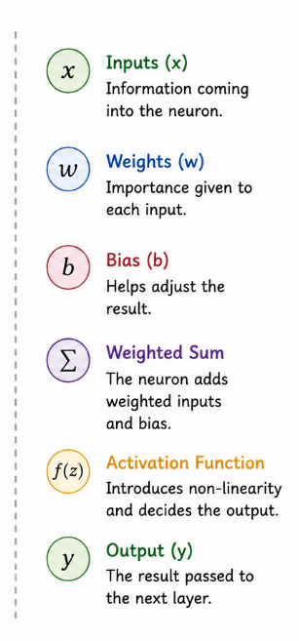
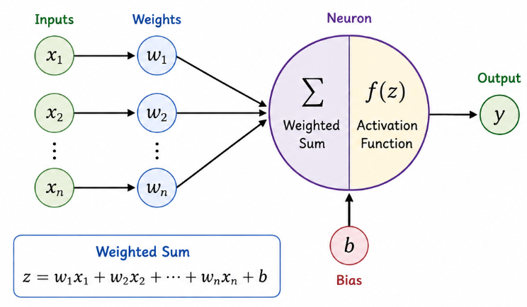
2 (ii). The Artificial Neuron (Con…)
13

Slide 14
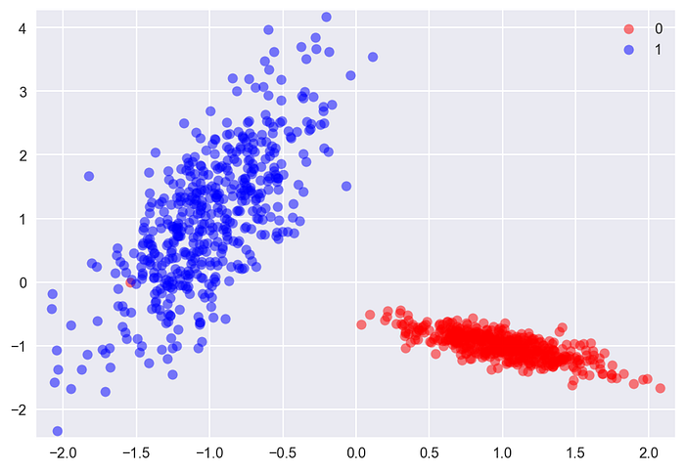
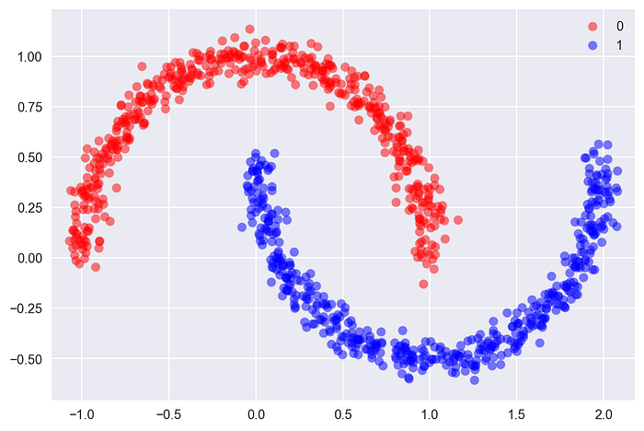
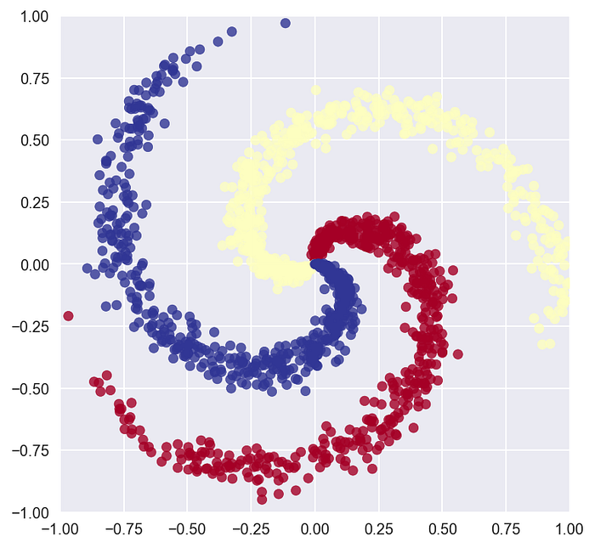
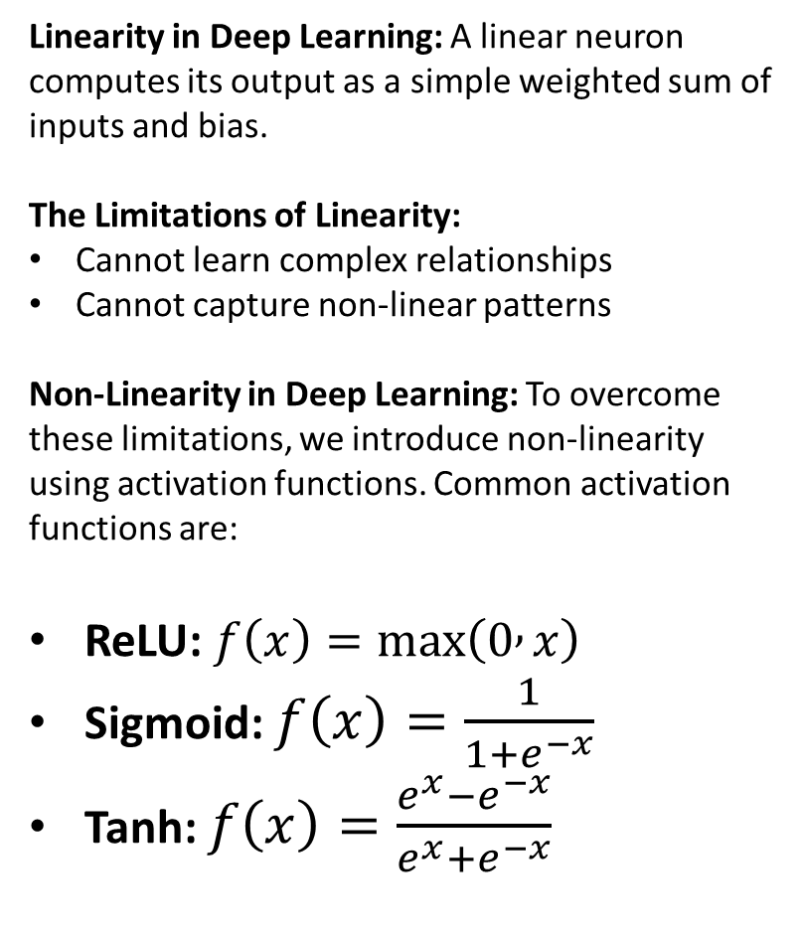
2 (ii). The Artificial Neuron (Con…)
Activation Functions in Artificial Neural Networks:
An Activation function is a mathematical formula that
Takes the neuron's calculated value and produces its output.
Determines how strongly a neuron should respond to its inputs and passes the resulting signal to the next layer.
Linearity in Deep Learning: A linear neuron computes its output as a simple weighted sum of inputs and bias.
The Limitations of Linearity:
Cannot learn complex relationships
Cannot capture non-linear patterns
Non-Linearity in Deep Learning: To overcome these limitations, we introduce non-linearity using activation functions. Common activation functions are:
ReLU: $f\left(x\right)=\max\left(0 , x\right)$
Sigmoid: $f\left(x\right)=\frac{1}{1+e^{−x}}$
Tanh: $f\left(x\right)=\frac{e^{x}−e^{−x}}{e^{x}+e^{−x}}$
An activation function can transform the value computed by a neuron in different ways. This transformation can be either linear or non-linear.
Tanh: hyperbolic tangent
14
Notes:
1. Intuitive Everyday Analogy
Linearity = A Straight Ruler / Proportional Change
Analogy: Buying apples at a fixed rate of $1 each. 1 apple = $1, 2 apples = $2, 10 apples = $10.
Key Concept: The output changes in direct proportion to the input. On a graph, it forms a straight line. If you stack multiple linear operations, you still just get a straight line.
Non-Linearity = Bends, Thresholds & Curves
Analogy: Water heating up. From 20°C to 99°C, it stays liquid. At 100°C, it suddenly boils into steam. The output doesn't just scale linearly—it drastically changes behavior at a threshold.
Key Concept: The output changes unpredictably, bends, or switches "ON/OFF". On a graph, it forms curves, corners, or steps.
2. Why Linear-Only Neural Networks Fail (The "Folded Paper" Example)
The Problem: Real-world data (like recognizing faces, stock prices, or spam) is chaotic and complex. A straight line cannot separate red and blue dots if they are arranged in a circle or a spiral.
The Math Analogy: If you stack 100 linear layers together, mathematically they simplify down to just 1 big linear layer ($y=mx+c$). No matter how deep your network is, without non-linearity, it behaves like a basic linear regression model.
3. How Activation Functions Add Non-Linearity
Non-linear activation functions bend and twist the decision boundaries so the network can fit complex, real-world patterns:
ReLU ($f\left(x\right)=\max\left(0,x\right)$): Acts like a light switch. If the input is negative, turn it OFF ($0$). If positive, pass it through. This simple "bend" at zero adds non-linearity.
Sigmoid / Tanh: Act like smooth "S-curves" that squash large inputs into a bounded range (e.g., between 0 and 1 for probabilities), flattening out extreme values. Common use in RNNs/sequence models.
Takeaway Quote: "Linearity lets us draw straight lines. Non-linearity lets us bend, curve, and fold space so the neural network can learn complex, real-world shapes.“
Tanh (hyperbolic tangent) is an activation function that converts a neuron's value to a range between −1 and +1.

Slide 15
2 (iii). Activation Functions
Why do we need an activation function?
A neuron first calculates a value, then the activation function controls the output.
Activation functions help neural networks learn complex patterns.
Three Important Activation Functions
Function | Main Idea | Common Use
ReLU | Keeps positive values, changes negative values to 0 | Hidden layers
Sigmoid | Converts a value to 0–1 | Binary classification
Softmax | Converts values into class probabilities | Multi-class classification
15

Slide 16
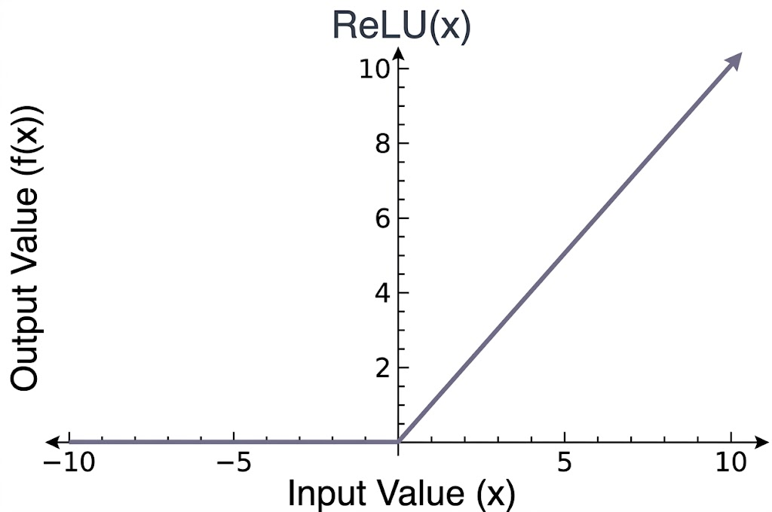
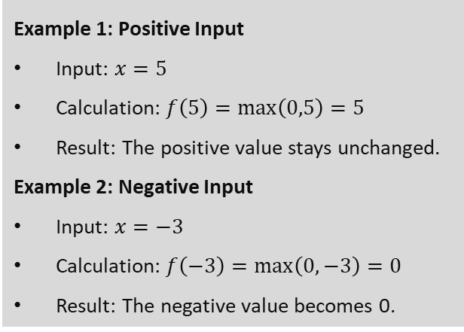
2 (iii). Activation Functions (Con…)
The Relu Operation
Change all negative values to 0
Leave all positive Values alone
f(x) = max(0,x)
Formula:
f(x) = max(0,x)
Example 1: Positive Input
Input: $x=5$
Calculation: $f\left(5\right)=\max\left(0,5\right)=5$
Result: The positive value stays unchanged.
Example 2: Negative Input
Input: $x=−3$
Calculation: $f\left(−3\right)=\max\left(0,−3\right)=0$
Result: The negative value becomes 0.
16

Slide 17
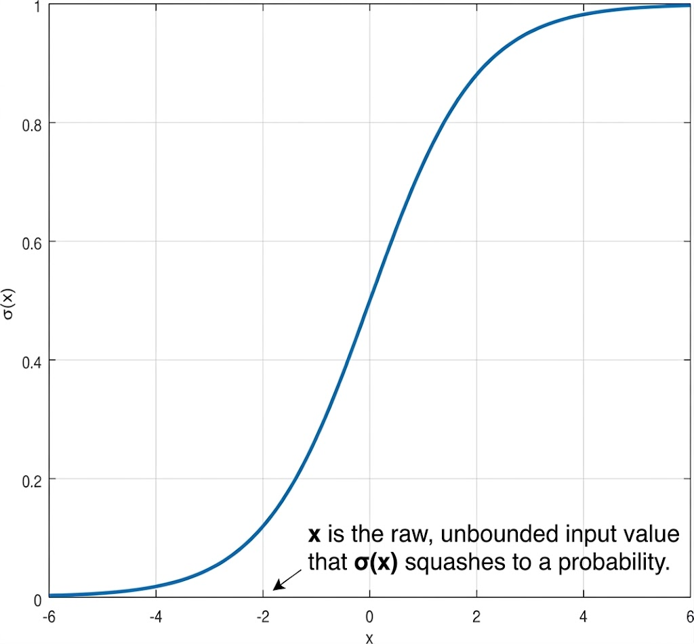
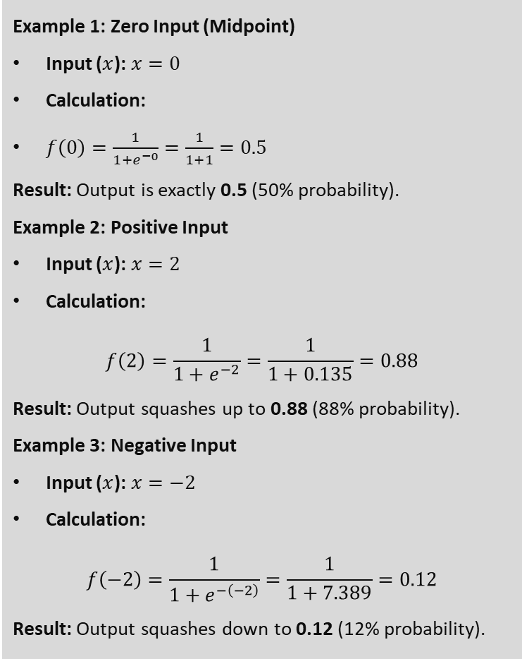

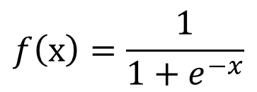
Sigmoid Function (Logistic)
2 (iii). Activation Functions (Con…)
Example 1: Zero Input (Midpoint)
Input ($x$): $x=0$
Calculation:
$f\left(0\right)=\frac{1}{1+e^{−0}}=\frac{1}{1+1}=0.5$
Result: Output is exactly 0.5 (50% probability).
Example 2: Positive Input
Input ($x$): $x=2$
Calculation:
$$f\left(2\right)=\frac{1}{1+e^{−2}}=\frac{1}{1+0.135}=0.88$$
Result: Output squashes up to 0.88 (88% probability).
Example 3: Negative Input
Input ($x$): $x=−2$
Calculation:
$$f\left(−2\right)=\frac{1}{1+e^{−\left(−2\right)}}=\frac{1}{1+7.389}=0.12$$
Result: Output squashes down to 0.12 (12% probability).
Converts values between 0 and 1
Useful for binary classification and probabilities
Formula:
$$f\left(x\right)=\frac{1}{1+e^{−x}}$$
$$σ\left(x\right):\text{Sigma} \text{x}→f \left(x\right)→Sigmoid out$$
17

Slide 18
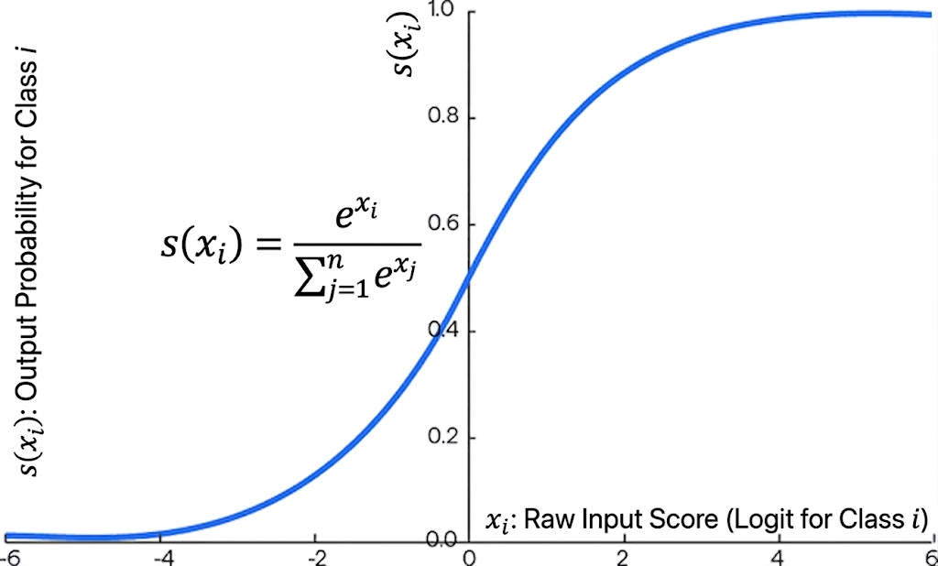

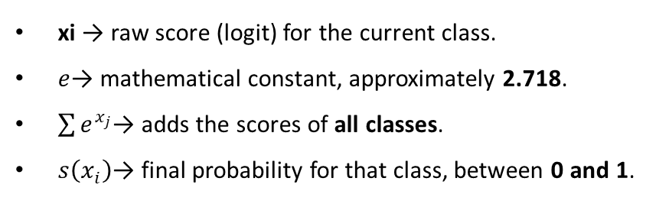
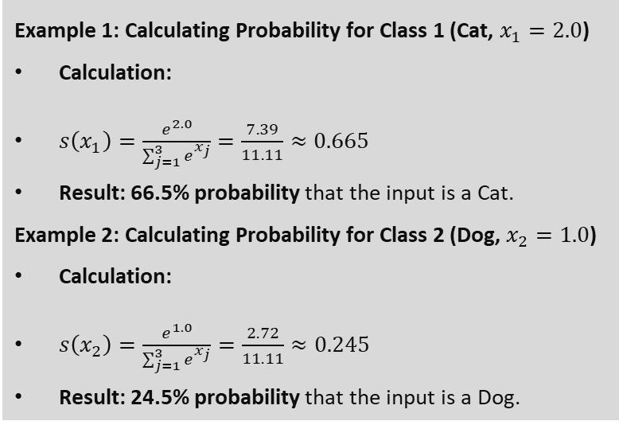
Softmax Function
2 (iii). Activation Functions (Con…)
Example 1: Calculating Probability for Class 1 (Cat, $x_{1}=2.0$)
Calculation:
$s\left(x_{1}\right)=\frac{e^{2.0}}{\sum_{j=1}^{3}{e^{x_{j}}}}=\frac{7.39}{11.11}≈0.665$
Result: 66.5% probability that the input is a Cat.
Example 2: Calculating Probability for Class 2 (Dog, $x_{2}=1.0$)
Calculation:
$s\left(x_{2}\right)=\frac{e^{1.0}}{\sum_{j=1}^{3}{e^{x_{j}}}}=\frac{2.72}{11.11}≈0.245$
Result: 24.5% probability that the input is a Dog.
Converts multiple values into probabilities between 0 and 1
The probabilities add up to 1
Used for multi-class classification to choose the most likely class.
$$s\left(x_{i}\right)=\frac{e^{x_{i}}}{\sum_{j=1}^{n}{e^{x_{j}}}}$$
Formula:
xi​ → raw score (logit) for the current class.
$e$→ mathematical constant, approximately 2.718.
$\sum{e^{x_{j}}}$→ adds the scores of all classes.
$s\left(x_{i}\right)$→ final probability for that class, between 0 and 1.
18

Slide 19
3. How Neural Networks Learn
19

Slide 20
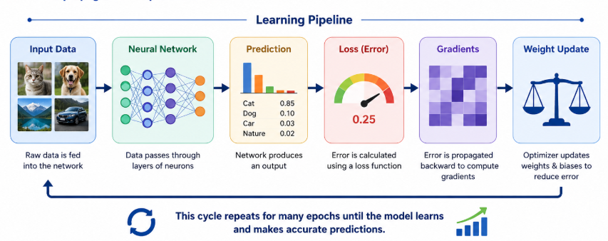
3. How Neural Networks Learn
A neural network learns by repeatedly:
Taking an input
Making a prediction
Measuring how wrong the prediction is
Finding which weights caused the error
Updating the weights
Repeating the process
Simple NN Video (<10 mints): https://youtu.be/SV2huMdNs9c
Learning = reducing the error over many examples.
20
Notes:
A gradient is a number that tells us how much and in which direction something changes. In deep learning, it mainly tells the network: “If I change this weight a little, how much will the error change?”
Simple example: Imagine you are going downhill and want to reach the lowest point.
Steep slope → you are far from the bottom and need to make a bigger adjustment.
Gentle slope → you are closer to the bottom, so make a smaller adjustment.
Slope = 0 → you may be at the bottom.
Similarly, during neural-network training:
Prediction → Calculate error → Calculate gradients → Adjust weights → Better prediction
The gradient tells the neural network how to adjust its weights to reduce the error.
A very simple analogy is “gradient = direction and amount of adjustment needed.”

Slide 21
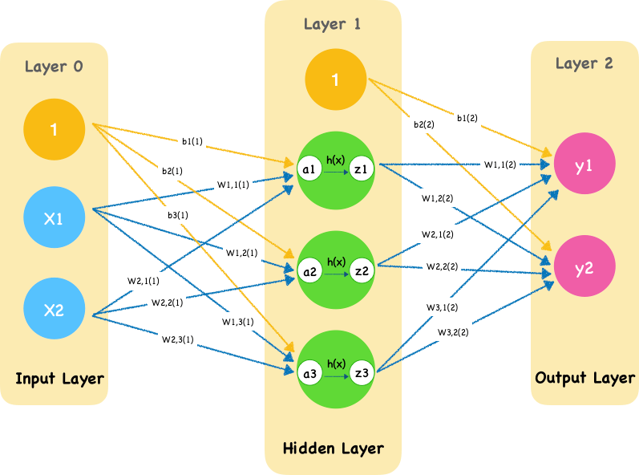
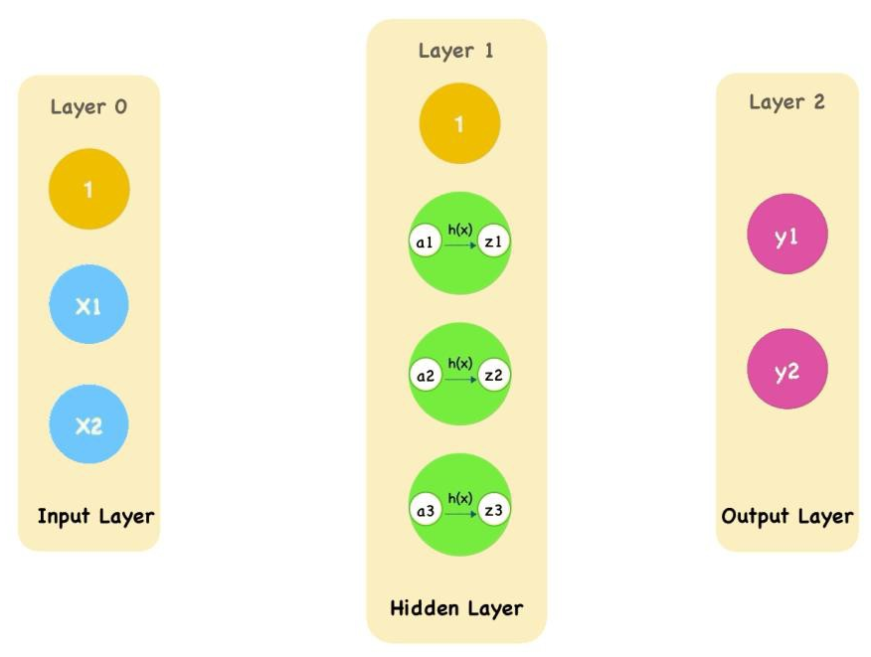
3 (i). Forward Propagation
Forward propagation is the process of moving information from the input layer to the output layer.
Steps:
Input data is provided to the input layer.
Weighted sum of inputs is calculated at each neuron.
Activation function is applied.
The output of each layer serves as input to the next
layer.
The final layer produces predictions.
Information moves forward through the network to produce a prediction.
21

Slide 22
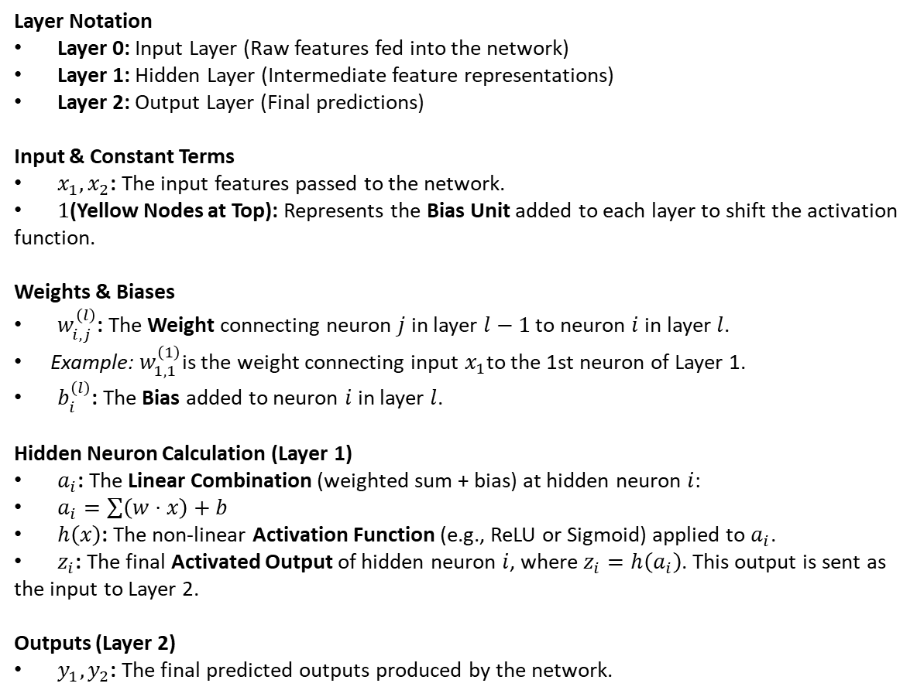
3 (i). Forward Propagation (Con…)
Layer Notation
Layer 0: Input Layer (Raw features fed into the network)
Layer 1: Hidden Layer (Intermediate feature representations)
Layer 2: Output Layer (Final predictions)
Input & Constant Terms
$x_{1},x_{2}$: The input features passed to the network.
$1$(Yellow Nodes at Top): Represents the Bias Unit added to each layer to shift the activation function.
Weights & Biases
$w_{i,j}^{\left(l\right)}$: The Weight connecting neuron $j$ in layer $l−1$ to neuron $i$in layer $l$.
  Example: $w_{1,1}^{\left(1\right)}$is the weight connecting input $x_{1}$to the 1st neuron of Layer 1.
$b_{i}^{\left(l\right)}$: The Bias added to neuron $i$in layer $l$.
Hidden Neuron Calculation (Layer 1)
$a_{i}$: The Linear Combination (weighted sum + bias) at hidden neuron $i$:
$a_{i}=\sum{\left(w⋅x\right)}+b$
$h\left(x\right)$: The non-linear Activation Function (e.g., ReLU or Sigmoid) applied to $a_{i}$.
$z_{i}$: The final Activated Output of hidden neuron $i$, where $z_{i}=h\left(a_{i}\right)$. This output is sent as the input to Layer 2.
Outputs (Layer 2)
$y_{1},y_{2}$: The final predicted outputs produced by the network.
22

Slide 23
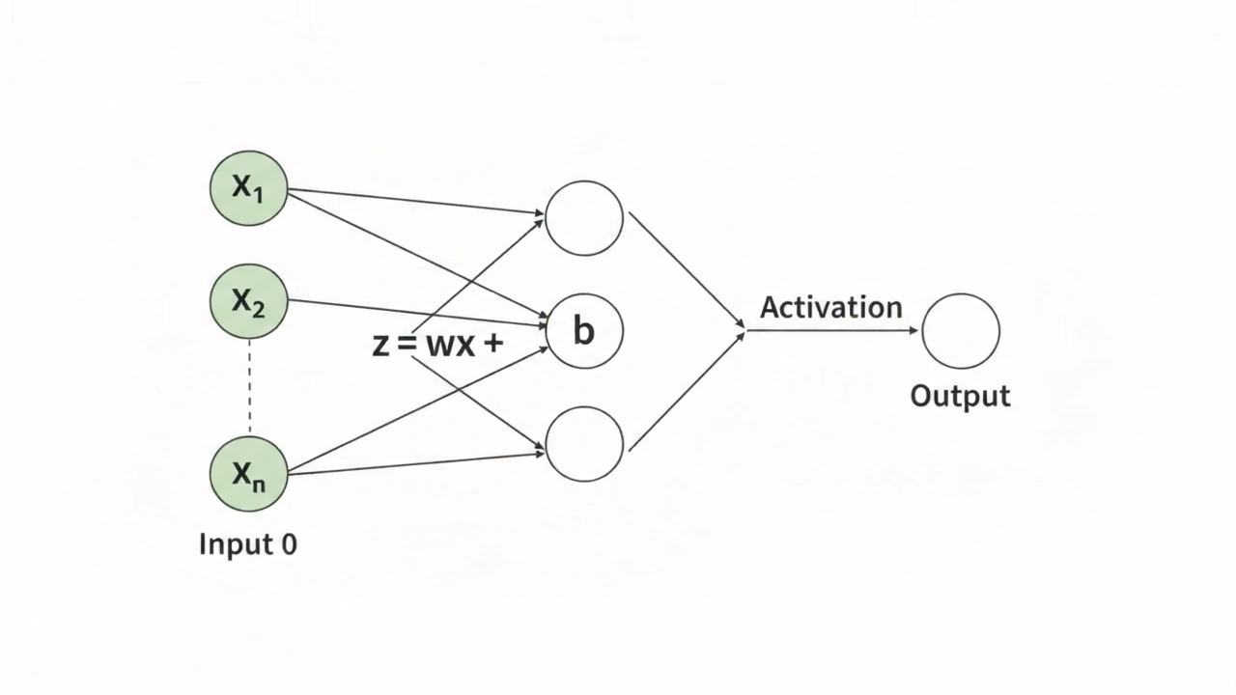
3 (i). Forward Propagation (Con…)
A short Video Clip
🎬 Watch 5-Sec Demo: How Data Flows Through Neural Networks
▶️ Press Play: Watch the Forward Pass in Action (5s)
⚡ Live Animation: See How Inputs Turn Into Predictions
23

Slide 24
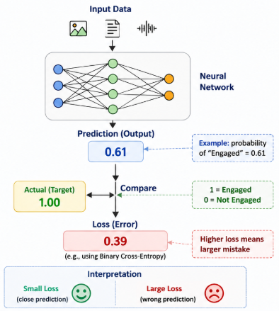
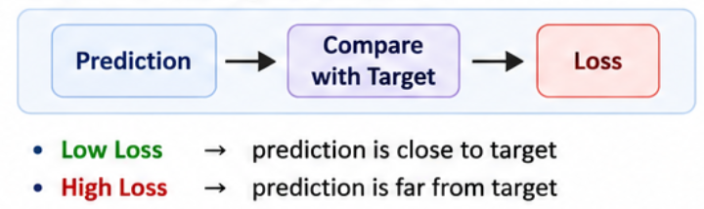
3 (i). Forward Propagation (Con…)
A neural network's prediction can differ from the actual target.
Example
Actual: Engaged Predicted: Not Engaged
Prediction Error:
The difference between the actual target and the network prediction.
Why does error occur?
Untrained parameters
Incorrect weights and biases
Complex or ambiguous data
Loss Function
Measures how wrong the prediction is.
24

Slide 25
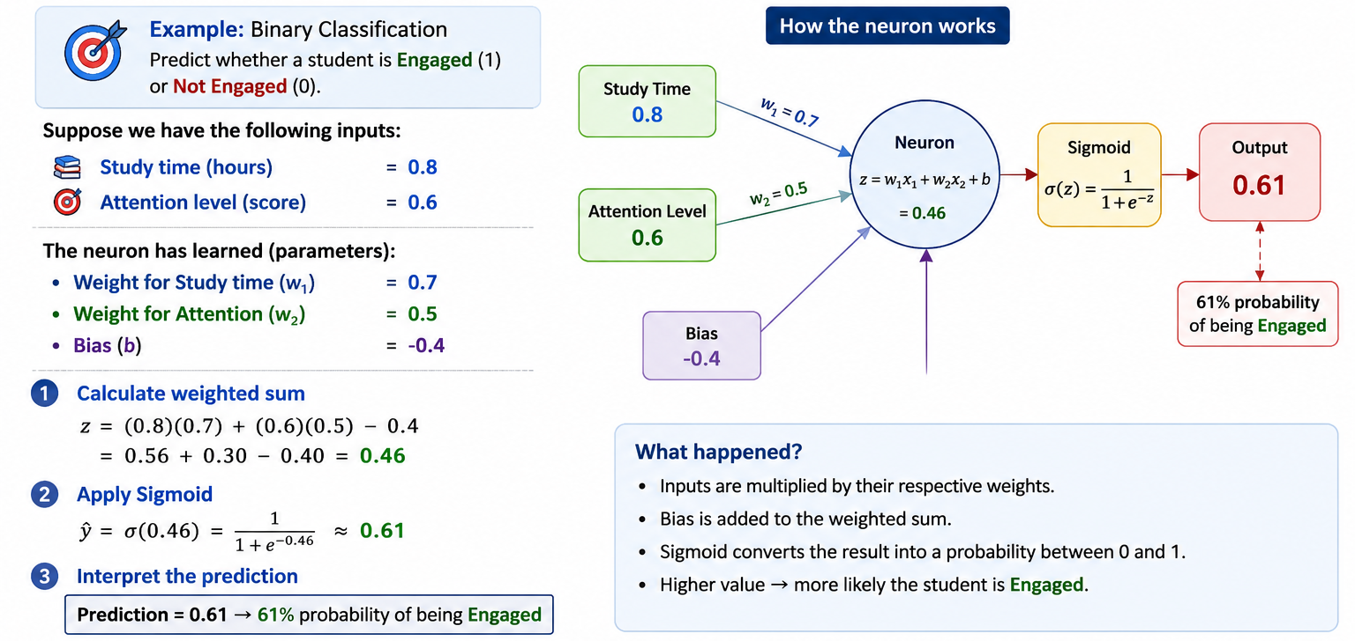
3 (i). Forward Propagation (Con…)
A Simple Prediction Example
25

Slide 26
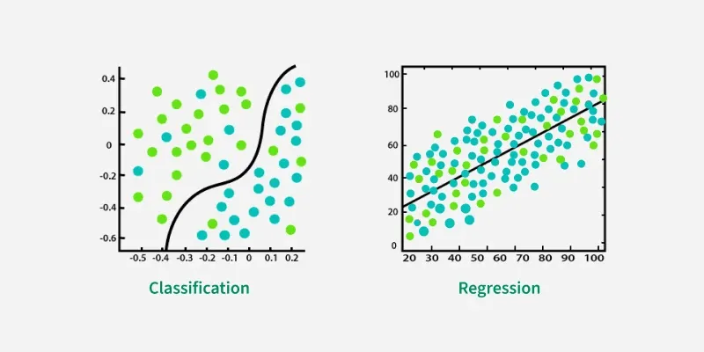
3 (ii). Loss Function / Cost Functions
Classification vs Regression
Feature | Classification | Regression
Main Purpose | Predicts a category or class | Predicts a numerical value
Main Question | Which class? | What value? / How much?
Output | Discrete labels | Continuous values
Examples | Spam / Not Spam, Disease / No Disease, Cat / Dog | House Price, Temperature, Sales
How It Works | Learns to separate data into different classes | Learns the relationship between inputs and numerical output
Main Concept | Uses a decision boundary between classes | Finds a best-fit line or curve
Example Output | Spam | $350,000
Common Activation | Sigmoid for binary classification; Softmax for multi-class classification | Often a linear output for predicting continuous values
Common Loss Functions | Binary Cross-Entropy, Categorical Cross-Entropy | MSE, MAE (Mean Absolute Error)
Simple Idea | Which group does it belong to? | What numerical value should it be?
26
Notes:
Pain example in Korea, Memorability, Aesthetic

Slide 27
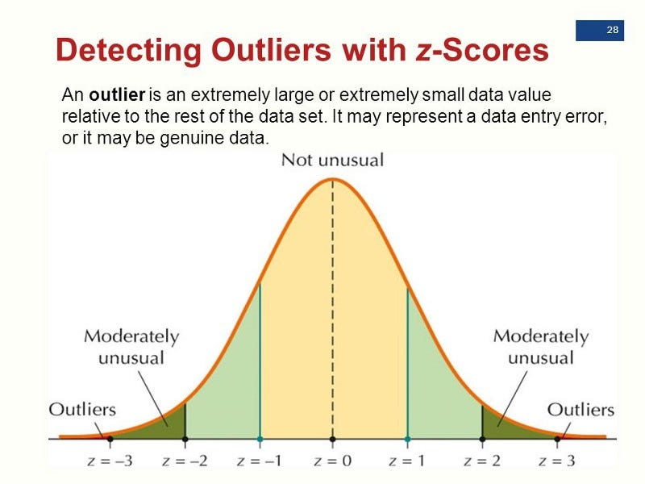
3 (ii). Loss Function / Cost Functions (Con…)
Loss Function:
A loss function measures the difference between the predicted output and the actual target.
It helps the neural network adjust weights during training to minimize errors.
Cost Function:
The cost function is the average of the loss function over the entire dataset.
It provides a single scalar value to optimize the model.
Types of Loss Functions in Neural Networks
Loss Function | Type | Use Case
Mean Squared Error (MSE) | Regression | Penalizes large errors, used for continuous values
Mean Absolute Error (MAE) | Regression | More robust to outliers than MSE
Binary Cross-Entropy | Classification | For binary classification (e.g., Yes/No, 0/1)
Categorical Cross-Entropy | Classification | For multi-class classification (e.g., Image Recognition)
Huber Loss | Regression | Combines MSE and MAE, handles outliers well
27

Slide 28
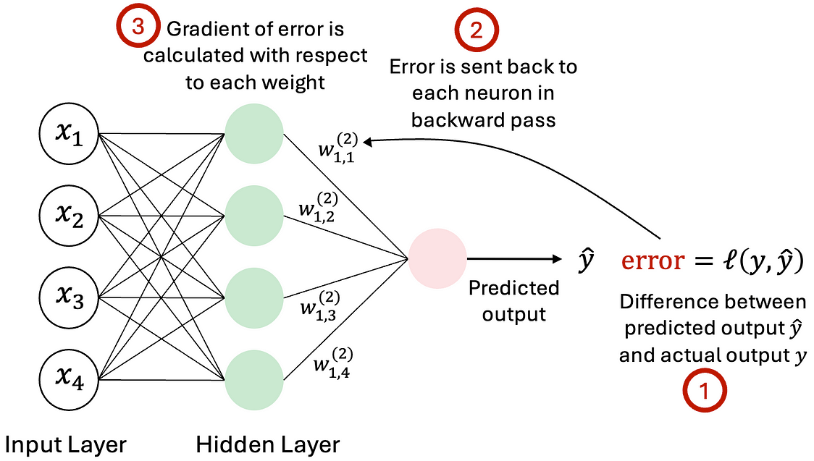
3 (iii). Backpropagation – Intuition
Backpropagation is an algorithm used to reduce the loss by adjusting the weights based on the error from the output layer to the input layer.
Key Steps:
Forward Pass → Pass the input through the network to get the output.
Calculate Loss → Compare the predicted output with the actual output.
Calculate Gradients → Find how each weight affects the loss using the chain rule.
Propagate Backward → Send the gradients backward through the layers.
Update Weights → Adjust the weights using gradient descent.
Repeat → Continue this process to reduce the loss.
Rumelhart, Hinton & Williams (1986)
Learning Representations by Back-Propagating Errors
Gradient of Loss: Shows how much the loss changes when a model parameter changes, and in which direction.
Gradient Descent: Uses the gradient to update the model parameters step by step to reduce the loss.
Partial Derivatives: Measure how the loss changes with respect to one parameter at a time, while keeping the others fixed.
Important Notes
Backpropagation adjusts weights using partial derivatives of the loss.
It propagates the error backward through the network to efficiently update the weights.
28
Notes:
A gradient is a number that tells us how much and in which direction something changes. In deep learning, it mainly tells the network: “If I change this weight a little, how much will the error change?”
Simple example: Imagine you are going downhill and want to reach the lowest point.
Steep slope → you are far from the bottom and need to make a bigger adjustment.
Gentle slope → you are closer to the bottom, so make a smaller adjustment.
Slope = 0 → you may be at the bottom.
Similarly, during neural-network training:
Prediction → Calculate error → Calculate gradients → Adjust weights → Better prediction
The gradient tells the neural network how to adjust its weights to reduce the error.

Slide 29
3 (iv). Optimization Algorithms
Optimization Algorithms:
Optimization algorithms adjust model parameters (weights) to minimize the loss function.
Efficient optimization ensures faster convergence and better model performance.
First-order derivative tells us the direction in which to change.
Adaptive automatically adjusts how much to change.
Popular Optimization Algorithms
Algorithm | Type | Characteristics
Stochastic Gradient Descent (SGD) https://scikit-learn.org/stable/modules/sgd.html | First-order | Updates weights using a single data point, faster but noisy
Momentum-based SGD https://arxiv.org/abs/2602.23444 | First-order | Adds momentum to reduce oscillations and speed up convergence
Adam (Adaptive Moment Estimation) https://arxiv.org/abs/1412.6980 | Adaptive | Combines momentum and adaptive learning rates, widely used
RMSprop https://www.geeksforgeeks.org/deep-learning/rmsprop-optimizer-in-deep-learning/ | Adaptive | Adjusts learning rates for each parameter, effective for deep networks
Adagrad https://arxiv.org/abs/2602.13112 | Adaptive | Adapts learning rate based on past gradients, suitable for sparse data
29

Slide 30
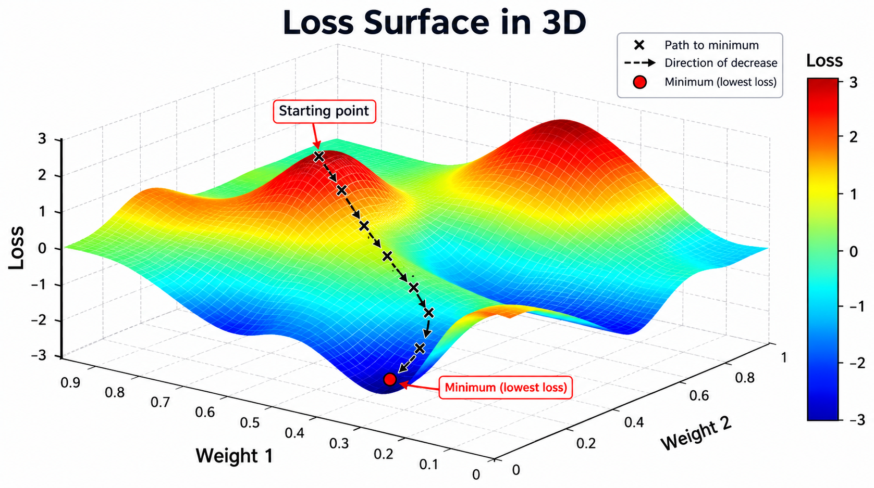
3 (iv). Optimization Algorithms (Con…)
Loss Optimization
We want to find the network weights that achieve the lowest loss
3D Loss Surface
Weight 1 & Weight 2: Represent two model weights.
Loss: Shows the model's error
  High Loss: Predictions are far from the actual values, so more learning is needed.
  Minimal Loss: Predictions are close to the actual values, so little adjustment is needed.
Peaks: Represent areas of high loss.
Valleys: Represent areas of low loss.
Crosses (×): Show the steps taken during training toward lower loss.
Minimum: The point with the lowest loss.
30

Slide 31
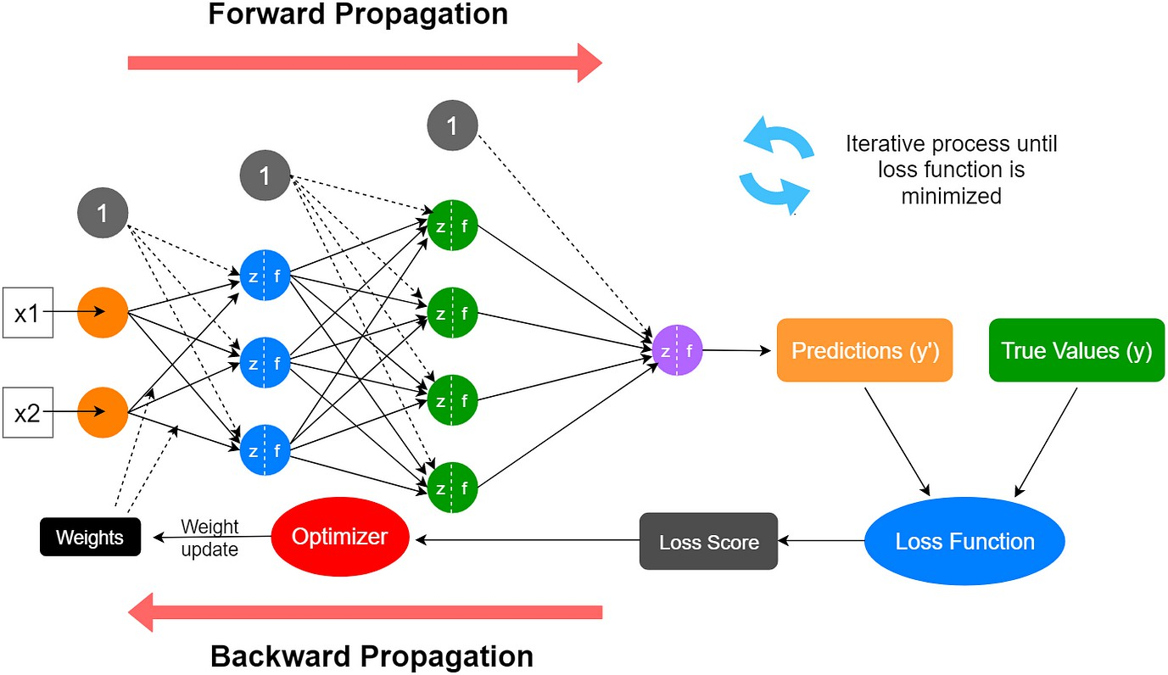
3 (v). Neural Networks Training Process – Overview
To train a neural network, we optimize its parameters using backpropagation and gradient descent.
Steps:
  Initialize weights & biases
  Forward pass (compute predictions)
  Compute loss – Measure how far predictions are from actual values.
  Backpropagation – Calculate gradients to adjust parameters.
  Update weights using gradient descent
  Repeat until convergence
  Evaluate and adjust hyperparameters
31

Slide 32
3 (v). Neural Networks Training Process – Overview (Con…)
x : Input — the information given to the neural network.
x₁, x₂ : Input features — two input values/features given to the network.
1 : Bias input — a constant value used to help the neuron adjust its output.
z : Weighted sum — the value calculated from inputs, weights, and bias.
f : Activation function — transforms z and produces the neuron's output.
32

Slide 33
4. Representation Learning
33

Slide 34
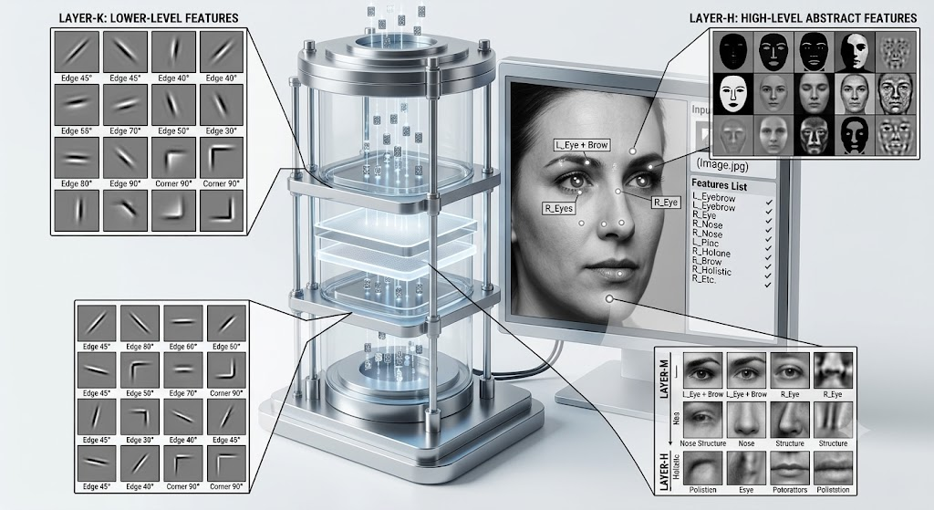
4. Representation Learning
Representation learning is when a neural network learns how to describe data in a useful way by itself.
Instead of humans manually choosing all the important features, the network discovers them from the data.
We do not manually tell the network to learn features. It discovers them during training.
The network learns what information is important for the task.
Why is it important?
Representation learning helps neural networks:
automatically learn useful features
work with complex data
find similarities between data
reduce the need for manual feature engineering
34

Slide 35
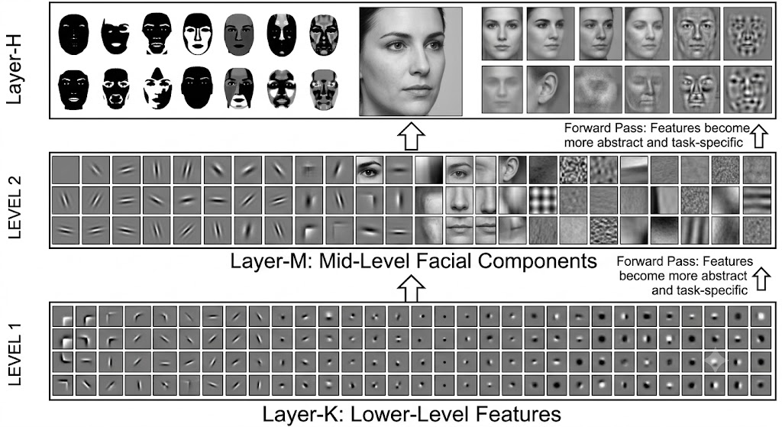
4 (i). Learned Features
A feature is a useful property of the input. Neural networks can learn features at different levels.
Example: Image
Early layers
  Learn simple patterns e.g., Edges, Lines, Colors , Corners
Middle layers
  Learn combinations e.g., Shapes, Textures, Parts of objects
Deep layers
  Learn more meaningful concepts e.g., Eyes, Faces, Wheels, Objects.
Simple features are learned first; more complex features are built from them.
35

Slide 36
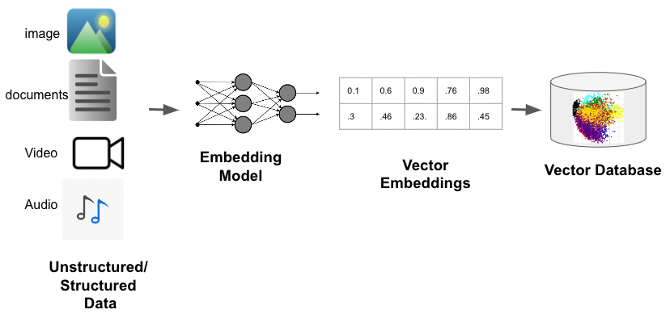
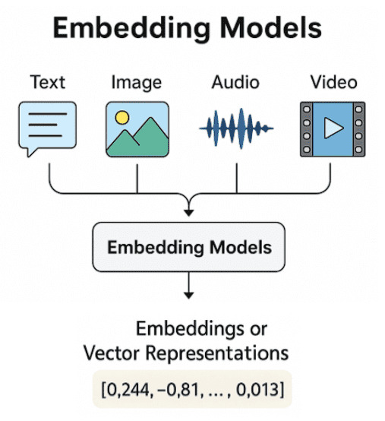
4 (ii). Embeddings
An embedding is a list of numbers that represents something in a way a model can work with.
Similar things have similar embeddings. The model learns these embeddings from data
Embedding = data converted into a useful numerical representation.
36
Notes:
A few well-known embedding models for reference:
Word2Vec — word embeddings; represents words as vectors based on their context.
Bidirectional Encoder Representations from Transformers (BERT) — contextual text embeddings; represents words/sentences based on surrounding context.
CLIP — multimodal embeddings; maps images and text into a shared embedding space.

Slide 37
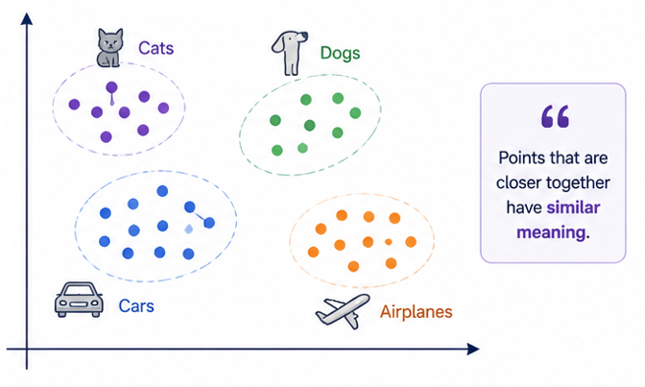
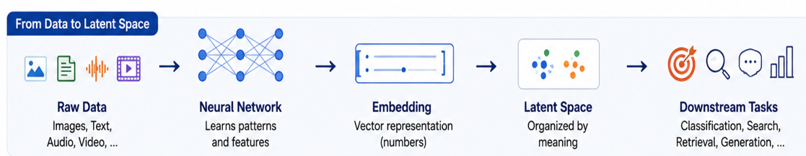
4 (iii). Latent Space
The latent space is a hidden space where the network stores useful information about the data.
Key Points
It is not directly visible or manually designed.
The model learns to place similar data points closer and dissimilar points farther.
It captures the important information while removing unnecessary details.
Helps in tasks like classification, clustering, retrieval and generation.
37

Slide 38
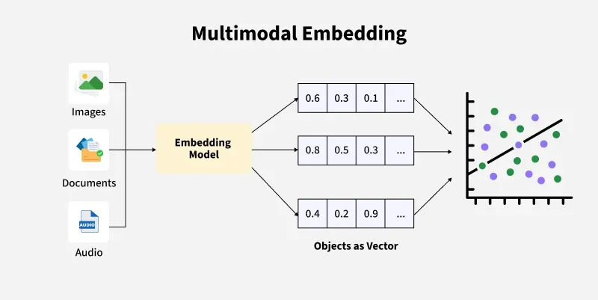
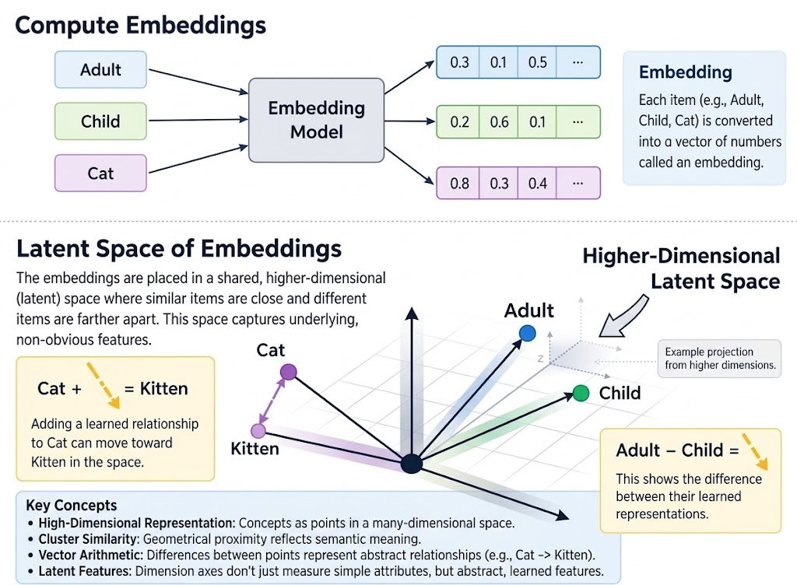
4 (iv). Embeddings & Latent Space
Embedding
Embedding: A numerical representation of an object that captures its meaning or important features.
Example: Cat → [0.8, 0.3, 0.4, …]
Latent Space
Latent Space: A learned space where embeddings are organized based on their meaning and relationships.
Similar objects → placed closer together.
Different objects → placed farther apart.
38

Slide 39
Next Topics
1. Multimodal Embeddings
2. Convolutional Neural Networks (CNNs)
I. Convolution Operation
3. Types of Layers
I. Max Pooling
II. Average pooling
4. CNN for Classification
I. Applications of CNNs
5. Transformer
I. Attention Mechanism
II. Why Transformers Matter for Multimodal AI
6. CNNs vs. Transformers
7. From CNNs & Transformers to Multimodal AI
2

